Slide 1

Block-chain based Online Ticket System
Saad Raja
Muhammad Faizan
Arslan Ashraf
Supervised by:
Dr. Faisal Bin Ubaid

Slide 2
FeedBack
FYP=> This Project/Project name.
Background is a part of introduction.
Literature review Added.
Project, Technical approach and Methodology Updated.
User Flowchart added.
References added.

Slide 3
CONTENTS
Software Requirements Specification (SRS)
Software Design Specification
(SDS)
Architecture Design Diagram
Class Diagram
Sequence Diagram
Entity Relationship Diagram (ERD)
Interface Design
01
Introduction (purpose)
01
02
Project scope
02
03
Operating Environment
03
04
System Features
04
05
Non Functional requirements
06
Use cases
05

Slide 4
Introduction (purpose)
Objective of the Software Requirement Specification Document:
Comprehensive documentation of requirements and specifications
Key Features of the Blockchain-Based Online Bus Ticketing System:
Search for buses based on location, date, time, and type
Reserve seats and select preferred payment methods
Save preferences for future bookings
Enhancements to Customer Experience:
Loyalty programs
Group booking discounts
Vacation packages
Blockchain Integration:
Ensures secure transactions
Real-time Bus Tracking:
Enable user to track the bus any time.
Additional Features for User Confidence:
Automated confirmation calls
24/7 customer support
Project Goals:
Deliver a robust, user-friendly, and secure platform
Exploration of blockchain technology, software development, and travel industry difficulties.

Slide 5
Project scope
Offer a secure system
Transparent
Efficient way to book bus tickets
Implementing block-chain technology
It ensures the integrity of transactions and enhances the overall user experience

Slide 6


Operating Environment

Slide 7

1)
Hardware platform
2)
Operating system
The system is designed to run on a variety of hardware platforms, Including :
Desktop computers
laptops
Smart phones
Tablets.
Users can access the system through web browsers.
The system should be compatible with multiple operating systems, such as
Windows
macOS
Linux
Android
iOS
to ensure broad accessibility for users.

Slide 8
3)
Block-chain infrastructure
DBMS
4)
Blockchain Component Overview:
Operates on a distributed network of nodes
Nodes run blockchain software
Node Characteristics:
Nodes may be hosted on various operating systems
Hardware configurations vary based on chosen blockchain technology (e.g., Ethereum, Hyperledger, etc.)
Relies on MongoDB
Manages and stores:
User data
Ticketing information
Transaction records

Slide 9
5)
Network Environment
6)
Web browser
Operates in a networked environment
Requires internet connectivity for user access
Compatibility with Network Technologies:
Compatible with various network technologies, including:
4G
5G
Wi-Fi
Wired connections
Users access the system via web browsers
Browser Compatibility:
Compatible with a wide range of browsers, including:
Google Chrome
Mozilla Firefox
Microsoft Edge
Safari
Other commonly used browsers

Slide 10
System Features

Slide 11
Ability to register and create accounts
Users can register using:
Email addresses
Mobile numbers
Enhances security and allows for personalization
Users can log in securely
Password reset and recovery options available
Helps user regain access in case of forgotten passwords or account recovery
User Registration and Authentication

Slide 12
This System should provide user to search for bus routes and schedules.
Users can search for available bus routes
Schedules based on departure and destination locations
Users can select preferred seats from a seating layout
Once seats are chosen, the booking process begins
User can confirm their seat choices
Seat Selection and Booking
Search for Bus Routes and Schedules

Slide 13
Users have the flexibility to pay for their tickets using different methods like
credit cards
debit cards
digital wallets
The payment process is both secure and easy to use
The system should provide real-time availability updates to its user
Real-time updates on seat availability and pricing
Ensuring users receive the latest information.
Transaction
Real-Time Availability Updates

Slide 14
The system should provide the booking confirmation notification through email or messages
users receive booking confirmation with a unique reference number and e-ticket details
The system should provide users with the ability to access and manage their bookings.
Including rescheduling or canceling tickets, if permitted.
Booking Confirmation
Booking Management

Slide 15
The system should provide 24/7 user support and assistance.
Address inquiries, issues, and provide assistance.
User Support and Assistance

Slide 16
Non Functional Requirements

Slide 17
Performance Requirements
The system should provide fast response times for task that user want to perform(like : Search, booking, payment).
Response times should be consistent under varying loads, and the system should handle peak usage efficiently
Security Requirements
The system should employ strong encryption to protect sensitive user data, payment information, and transactions.
User authentication and authorization mechanisms should be in place to prevent unauthorized access.
Scalability Requirements
The system must be scalable to handle an increasing number of users and booking transactions, particularly during peak travel times or special events.
Scalability should be achieved without degrading the system's performance.

Slide 18
Use Case Requirement

Slide 19
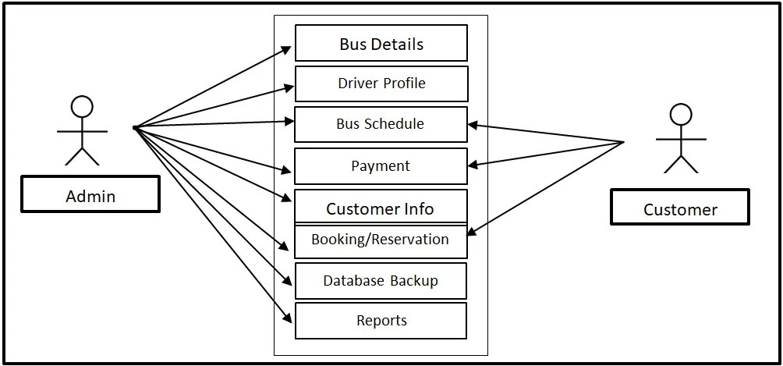
Use Case Diagram

Slide 20
Software design specification (SDS)

Slide 21
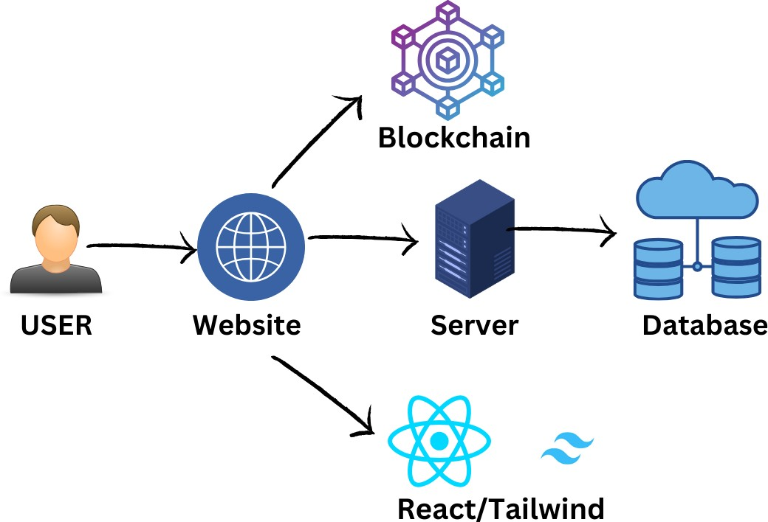
Architecture design diagram

Slide 22
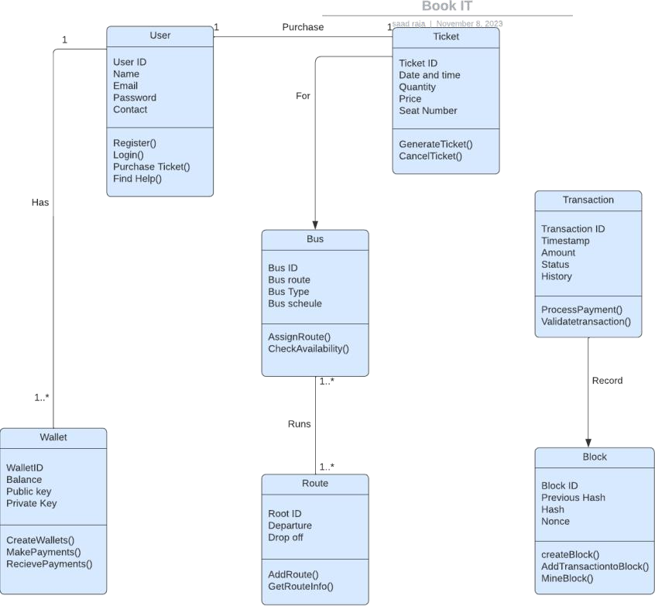
Class Diagram

Slide 23
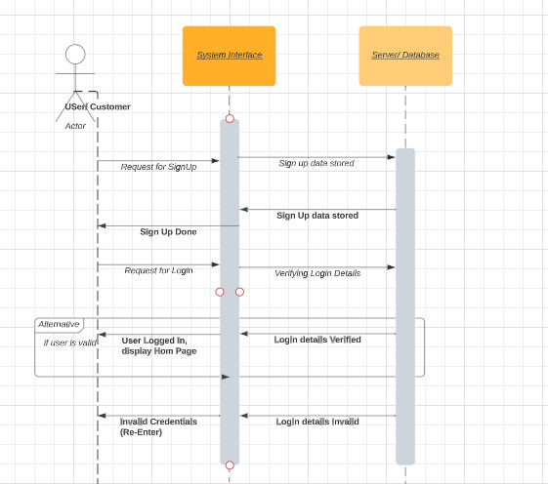
Sequence Diagram
Sign Up Sequence Diagram

Slide 24
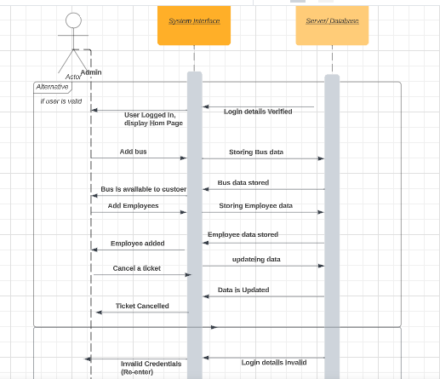
Admin Sequence Diagram

Slide 25
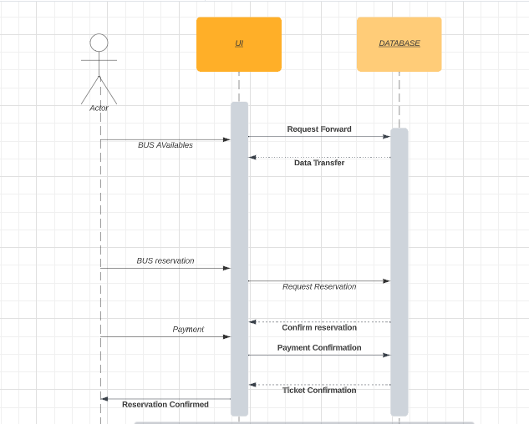
User Sequence Diagram

Slide 26
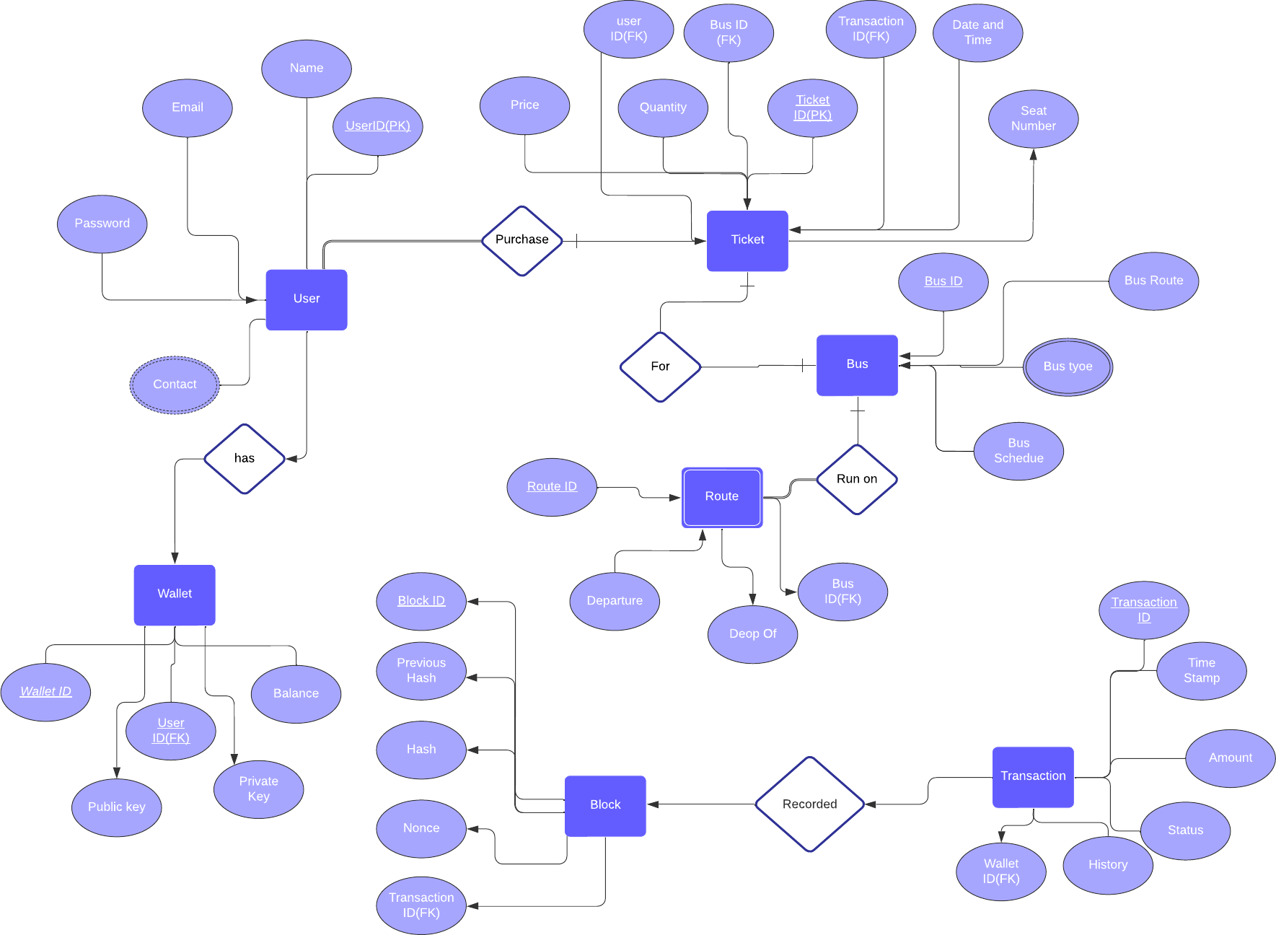
Entity Relationship
Diagram

Slide 27
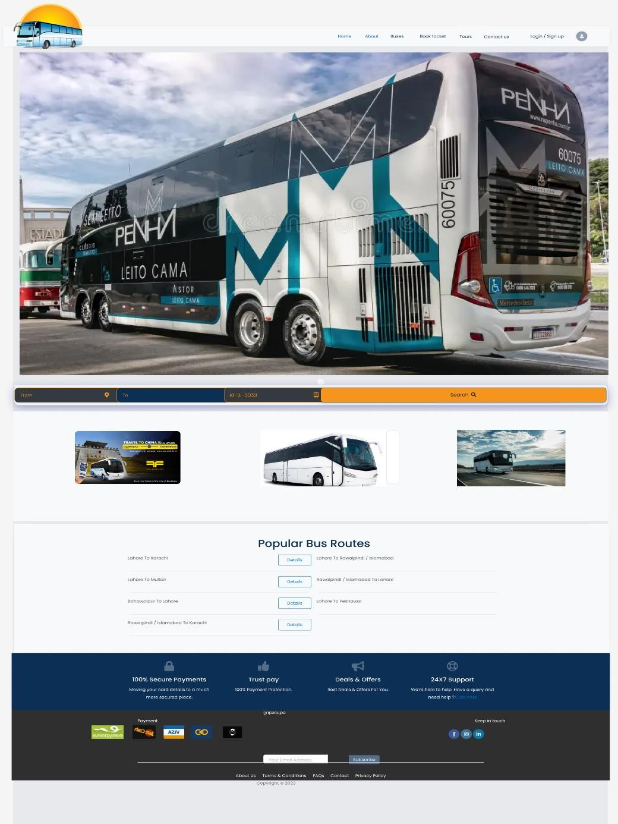
User interface design
Home Page

Slide 28
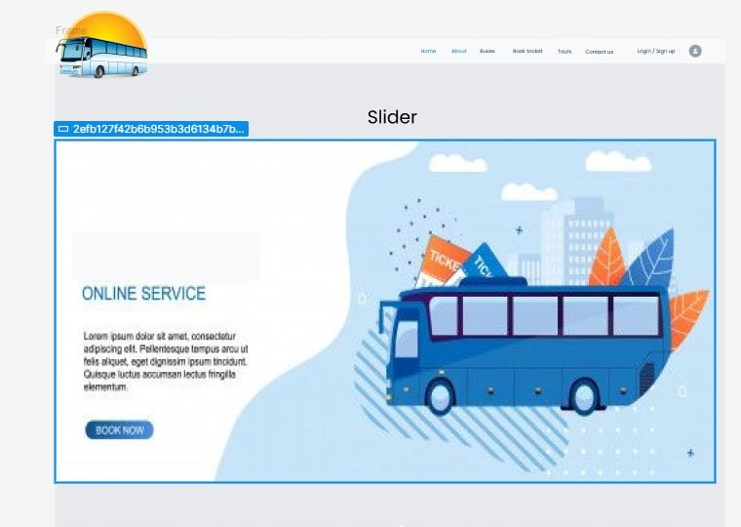
About page

Slide 29
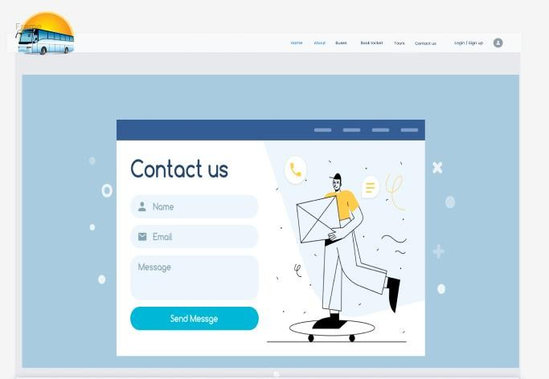
Contact US

Slide 30
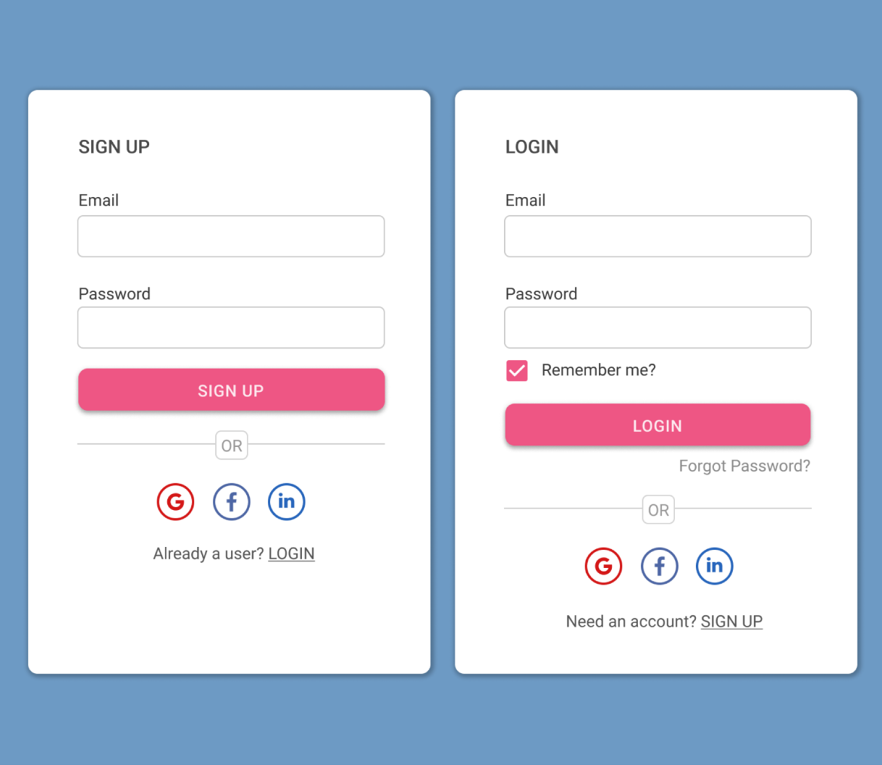
Sign Up or Login page

Slide 31
THANKYOU

